Slide 1
Handover from the Ad Hoc EUHTF Working Group to the EUHTF Advisory Group
EU Health Task Force
ECDC, Stockholm – 25/01/2024

Slide 2
Annual EUHTF meeting
EU Health Task Force
ECDC, Stockholm – 25/01/2024

Slide 3
Meeting agenda
Day 1 | Thursday 25 January 2024 - Semmelweis room, 9th floor
12:30-13:00 | Registration
13:00-13:15 | Welcome and opening by ECDC Director, Andrea Ammon
13:15-13:45 | Introduction of the Annual EUHTF meeting participants
13:45-14:15 | Session 1: Overview of the EU Health Task Force New mandate, composition, governance bodies, list of activities, criteria/prioritisation, coordination with European Commission and GOARN
14:15-15:00 | Session 2: EUHTF support EUHTF assignments in 2023 Process for national authorities to request EUHTF support
15:00-15:30 | Coffee Break, Social area 5th floor
Notes:
Thomas/Ettore

Slide 4
Meeting agenda
Day 1 | Thursday 25 January 2024 - Semmelweis room, 9th floor
15:30-16:30 | Session 3: The EU Health Task Force in the European and global landscape - Panel discussion Chair: Thomas Hofmann Objectives: Share knowledge and lessons learnt from national and supranational initiatives to support preparedness and response to public health emergencies Identify existing gaps in international preparedness and response support
16:30-17:30 | Session 4: Process to be part of the EUHTF Member State pool Registration in the pool Participation to EUHTF assignments
17:30-18:00 | Wrap-up day 1
18:00-20:00 | Dinner, 9th floor, ECDC
Notes:
Thomas/Ettore

Slide 5
Meeting agenda
Day 2 | Friday 26 January 2024 - Semmelweis room, 9th floor
09:00-09:45 | Session 5: Opportunities for the Enhanced Emergency Capacity pool of experts
09:45-10:30 | Session 6: Expectations for 2024 Presentation of the new EUHTF Advisory Group Reflections on the work done in 2023 Expectations and plans for 2024
10:30-11:00 | Coffee Break, Social area 5th floor
11:00-12:00 | Session 7: Next steps in the EUHTF operationalisation with Member States and international partners
12:00-12:30 | Conclusion and meeting closure – Thomas Hofmann
 | Group photo, lobby area, 5th floor
12:30-13:30 | Lunch, 5th floor (take away wrap)
Notes:
Thomas/Ettore

Slide 6
House keeping
The meeting will be recorded for minutes taking purpose. In case of objection, no recording will be performed
Report distributed to participants. An executive summary will be made public on ECDC website
ECDC-funded participants will be eligible to claim their per diems upon signing in the attendance list
Instructions for reimbursement
Coffee break at ground floor (5th floor) (both 25 and 26 Jan)
Dinner at this floor (9th floor) at 18:00 on 25 Jan
Group picture at the lobby (5th floor) after meeting closes on 26 Jan
After group photo, there is lunch to go (5th floor) on 26 Jan
Your active participation and contributions throughout the meeting are essential!
Notes:
Hanh

Slide 7
ECDC Coordination Team
Vicky Lefevre, chair - Head of Unit – Public Health Functions
Thomas Hofmann, Head of Section - Emergency Preparedness and Response Support
Ettore Severi – Lead EPR Readiness and Support Group
Adriana Romani - EPRS
Daniel Cauchi – EPRS
Dorothée Obach– EPRS
Emma Löf - EPRS
Hanh Vu Hong – EPRS
Katarina Johansson – PHF
Orla Condell – EPRS
Sara Forato – EPRS
Svetla Tsolova – EPRS
Notes:
Ettore

Slide 8
EU Health Task Force Advisory Group
GOARN representative
Gianluca Loi, GOARN OST
WHO EURO
Oleg Storozhenko
Adela Paez (alternate)
Médecins Sans Frontières (MSF)
Daniela Garone
European Public Health Association
Ricardo Mexia
ECDC Coordination Team
MS Representatives
Bernardo Guzmán Herrador, Spain
Claudia Siffczyk, Germany
Guido Benedetti, Denmark
Mairin Boland, Ireland
Otto Helve, Finland
Paula Vasconcelos, Portugal
European Commission DG representatives
Anna Battistutta, DG ECHO
Isabella Panunzi, DG HERA
Evelyn Depoortere, DG RTD
Laura Gillini, DG SANTE
Alexandre Jully, DG ECHO (alternate)
European Medicines Agency
Manuela Mura
Notes:
Ettore

Slide 9
Member States participants
No. | Country | Experts
1 | Austria | - Bernhard Benka
2 | Belgium | - Gauthier Willemse - Jorgen Stassijns
3 | Bulgaria | - Kalina Petkova - Zhivka Getsova
4 | Czech Republic | - Tomas Kotesovec - Zdenek Kysely
5 | Denmark | - Søren Neermark
6 | Estonia | - Andras Armväärt - Kärt Sõber
7 | Finland | - Hannu Kiviranta
No. | Country | Experts
8 | France | - Clément Lazarus - Harold Noel
9 | Germany | - Florian Schwöbel - Meike Schöll
10 | Hungary | - Agnes Danielisz - Agnes Galgoczi
11 | Iceland | - Gudrun Aspelund
12 | Ireland | - Éamonn O’Moore
13 | Italy | - Flavia Riccardo
14 | Latvia | - Indra Linina
15 | Lithuania | - Paulius Gradeckas
Notes:
Ettore

Slide 10
Member States participants
No. | Country | Experts
16 | Luxembourg | - Sébastien Français
17 | Netherlands | - Peter Steenhuis
18 | Norway | - Øystein Riise - Steinar Olsen - Emily MacDonald
19 | Poland | - Aleksandra Czyrznikowska - Izabela Omasta
20 | Portugal | - Mariana Ferreira - Renato Lourenço Silva
No. | Country | Experts
21 | Romania | - Calin Alexandru - Lavinia Rusu
22 | Slovakia | - Lucia Paulíková
23 | Slovenia | - Luka Gorup - Nuška Čakš Jager
24 | Spain | - Marta Catalinas Pérez
25 | Sweden | - Andreas Bråve - Anette Richardson
Notes:
Ettore

Slide 11
Other organizations/initiatives
No. | Organizations/Initiatives | Experts
1 | Africa CDC | - Merawi Tegegne - Neema Kamara
2 | Eastern Mediterranean Public Health Network | - Haitham Bashier - Rawan Araj
3 | Fellowship Program | - Maria João Cardoso
4 | G7 - Germany | - Christophe Bayer
5 | WHO HQ - Global Health Emergency Corps | - Scott Dowell
6 | WHO HQ | - Marion Muehlen
Notes:
Ettore

Slide 12
Session 1: Overview of the EU Health Task Force
Notes:
Dorothee

Slide 13
Background
Pandemic lessons learned
New ECDC mandate*
Establish the EU Health Task Force mechanism
(Article 11a)
Shortcomings in EU mechanisms for managing threats
Lack of readily available human resources for timely deployment
Effective operational response and crisis preparedness support to EU/EEA and global health security
Creation and coordination by ECDC, in collaboration with EU/EEA countries, European Commission, and EU partners
→ Need for a stronger EU deployable work force
*Regulation (EU) 2022/2370 of the European Parliament and of the Council
Notes:
Dorothee

Slide 14
Composition of the EUHTF
ECDC Coordination Team
Permanent entity coordinating EUHTF activities: Public health experts Emergency operations centre staff Administrative assistance
Enhanced Emergency Capacity
EUHTF pools including experts from: ECDC staff ECDC Fellows (e.g. EPIET, EUPHEM) EU/EEA Member State experts, on a voluntary basis
Tasks
Tasks
Coordination, including for deployments
Development of administrative, readiness and mobilisation procedures
Training and capacity building activities
Communications and coordination with partners, including internal and external advisory bodies
Field deployments
Remote technical support
Community of knowledge and practice
  Regular meetings
  Sharing experience, protocols, tools
  Participate in trainings
Notes:
Dorothee

Slide 15
Governance of the EUHTF
ECDC Coordination Team
EUHTF Ad Hoc Working Group
(year 2023)
EUHTF Advisory Group
(year 2024)
- ECDC Coordination Team
- European Commission (ECHO, HERA, RTD, SANTE)
- Six selected MS (rotating)
- GOARN
- WHO Regional Office for Europe (WHO/Europe)
- European Medicines Agency (EMA)
- European Public Health Association (EUPHA)
- Non-Governmental Organisation (Médecins Sans Frontières (MSF)
ECDC experts
- ECDC Coordination Team
- European Commission (ECHO, HERA, RTD, SANTE)
- Six selected MS
- GOARN
- Communications and coordination
- Development of administrative, readiness and mobilisation procedures
Advise and assist ECDC Coordination Team with:
- Operational, administrative and technical decisions
- Annual work plan priorities
- Development of administrative, readiness and mobilisation procedures
Advise and assist ECDC Coordination Team with:
- Operational, administrative and technical decisions
- Annual work plan priorities
- Opportunities for international collaboration

Slide 16
Activities supported by the EUHTF
Preparedness | Review of preparedness and response plans, development or review of guidelines/protocols related to specific technical areas | Surveillance, public health laboratories, infection prevention and control, EOC, points of entry, etc.
 | Testing of preparedness and response plans, or plans related to specific technical areas | Simulation exercise
 | Review implementation of preparedness and response actions | In-Action Reviews (IAR), After-Action Reviews (AAR)
 | Support implementation of capacity building activities | Actions/recommendations identified through other activities (e.g. country assessments) or other identified capacity building needs
 | Support threat detection activities | SOPs for monitoring mass gathering events, set-up epidemic intelligence, strengthen surveillance
Response | Threat detection and monitoring, including during outbreak or following disasters | Development, strengthening or operation of surveillance systems
 | Outbreak investigation and emergency response / response management | EOC operations, epidemiological investigations, rapid threat and risk assessment, molecular epidemiology, etc.
 | Emergency Operations Centre (EOC) | Develop and implement an incident management system, maintain and develop incident management tool(s)
 | Operational research in the context of an outbreak response | Develop protocols, cross border studies, data analysis, support for collaboration with external partners/stakeholder including relevant EU initiatives, etc.
Not considered as exhaustive, further request assessed by the ECDC Coordination Team
Notes:
Dorothee

Slide 17
Criteria for a request for support
Focus on one country or one crisis and a related emergency preparedness or response area of work:
Technical support for an outbreak of an infectious disease or of unknown origin, focused on investigation, prevention and control activities, including surge capacity support during times of crisis
OR
Technical support for an ad hoc preparedness activity that is country/setting specific and addresses a specific technical gap
AND
Technical support that is time limited in nature (≤6 weeks of intensive work) or does not involve intensive work over medium- long-term
AND
Technical support related to the above points, that will have a clear public health impact for EU/EEA or globally
Notes:
Dorothee

Slide 18
Prioritisation
Of requesting organisations / authorities:
  EU/EEA countries
  EU pre-accession countries
  Potential candidate countries to EU
  European Neighbourhood Policy countries
  Other third countries
Of activities:
  Response > Preparedness
  Response with a potential for multi-country spread > limited potential spread
  Response to events with a high severity and/or high public health impact > Response to events with less severity and/or less impact
Notes:
Dorothee

Slide 19
Coordination with European Commission and GOARN
European Commission and GOARN part of the EUHTF Advisory Group
  EC sending requests to EUHTF
  Deployment through the EUHTF
Coordination with DG ECHO
  Online trainings can be shared with EUHTF expert pool
  Experts to be deployed through UCPM
To align work and provide support, ECDC Coordination Team members join the GOARN:
  Operational research Advisory Group
  Operational research Technical Working Group
  Leadership training
Working on co-deployment with GOARN and DG ECHO
EUHTF to apply and become a GOARN member
Notes:
Dorothee

Slide 20
Session 2: EUHTF support

Slide 21
Update on EUHTF assignments 2023 – (1/3)
Ongoing requests
Country | Date request | Technical Area/Topic | Support provided by EUHTF to date | Next actions
France | 24/05/2023 | Preparedness and Response during a mass gathering events: surveillance and response during Olympic games 2024 | Visit of ECDC expert to country Follow-up of Rugby World Cup and exchanges with surveillance team at SpF | EI training for 1-2 SpF expert in February RRA training under consideration Monitoring during OG
Ireland | 08/05/2023 | Multi-country operational research study on iGAS: risk factors and surveillance strategy | Developed protocol and database for data collection Data sharing agreement Engagement of EUPHEM fellow to support analysis Survey on surveillance system for GAS and iGAS Presentation at Public Health Protection Conference in Dublin 12/10/23 7 countries shared data, 1 still remaining | Last data collection Data cleaning and analysis Manuscript or report or presentation at a conference Guidelines for surveillance
Notes:
Emma

Slide 22
Update on EUHTF assignments 2023 – (2/3)
Country | Date request | Technical Area/Topic | Support provided by EUHTF to date | Next actions
Slovenia | 01/06/2023 | AAR on implementation of PHSM, vaccination deployment and risk communication during the COVID-19 pandemic | Arranged, facilitated in person the AAR AAR report under clearance Report could be published | Completion after publication
Germany | 09/06/2023 | Multicounty lessons learned workshop/AAR on cooridnation between public health and international airports during COVID-19 pandemic | Technical support to arrange, host, facilitate a workshop bringing together public health and representatives from major EU airport hubs Identify lessons learned for future emergencies: focus on operational/practical aspects | Workshop planned early April 2024, bac-to-back with CAPSCA meeting
Latvia | 25/09/2023 | Workshop OI, EI tools | Need to train new colleagues on outbreak investigation and tools for outbreak detection and data collection: Offered 2 day F2F workshop, training material etc. | Compile curriculum Internal meeting 7/12 2nd call with L 12/12 Planned for first half 2024
Notes:
Emma

Slide 23
Update on EUHTF assignments 2023 – (3/3)
Pending requests
Country | Date request | Technical Area/Topic | Support provided by EUHTF to date | Next actions
Germany | 19/10/2023 | UEFA football Euro cup: surveillance and risk assessment | Support with the monitoring of events Joint risk assessment with DE and WHO EURO for public health advice | Wait for DE feedback
Requests on hold
Country | Date request | Technical Area/Topic | Support provided by EUHTF to date | Next actions
Belgium | 11/05/2023 | Simulation exercice on avian influenza | Technical support to develop scenario for the SimX | Follow-up beginning 2024
Ireland | 03/08/2023 | Avian flu cross-border Simulation exercise | Review of IE scenario | Follow-up beginning 2024
Notes:
Emma

Slide 24
Update on EUHTF assignments – Completed
Completed requests related to response
Country | Date request | Technical Area/Topic | Support provided by EUHTF to date | Date completed
Ukraine | 08/06/2023 | RRA related to a flooding event | ECDC team support to urgently draft a RRA for Ukrainian MOH, deadline 48 h, not for publication | 19/06/2023
Completed request related to preparedness
Country | Date request | Technical Area/Topic | Support provided by EUHTF to date | Date completed
Slovenia | 20/07/2023 | Preparedness guidance: National workforce capacity estimation | Technical support on methodology to map workforce capacity and provide technical inputs/review on needs/gaps Back-to-back in person meeting with AAR | 15/11/2023
Lithuania | 01/03/203 | AAR on contact tracing and case management during COVID-19 pandemic | Arranged, facilitated in person the AAR AAR report produced MS expert from neighbouring country joined | 12/12/2023
Notes:
Emma

Slide 25
EUHTF assignments in 2023
Experience from Maria João Cardoso EUPHEM fellow who worked on the EUHTF project on iGAS
Notes:
Maria

Slide 26
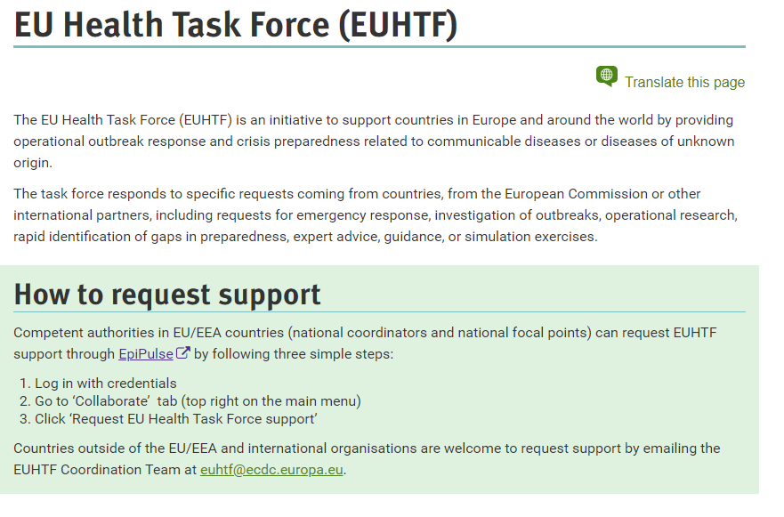
Process for ministries of health and public health institutes to request EUHTF support
Notes:
Emma

Slide 27
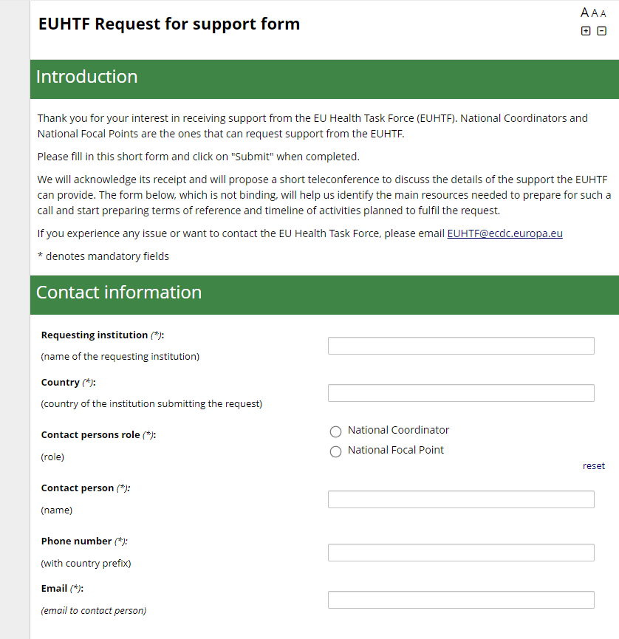
Process for ministries of health and public health institutes to request EUHTF support
Form for collecting basic information in a structured way
Contact information
Short description of support needed
Anticipated time
Notes:
Emma

Slide 28
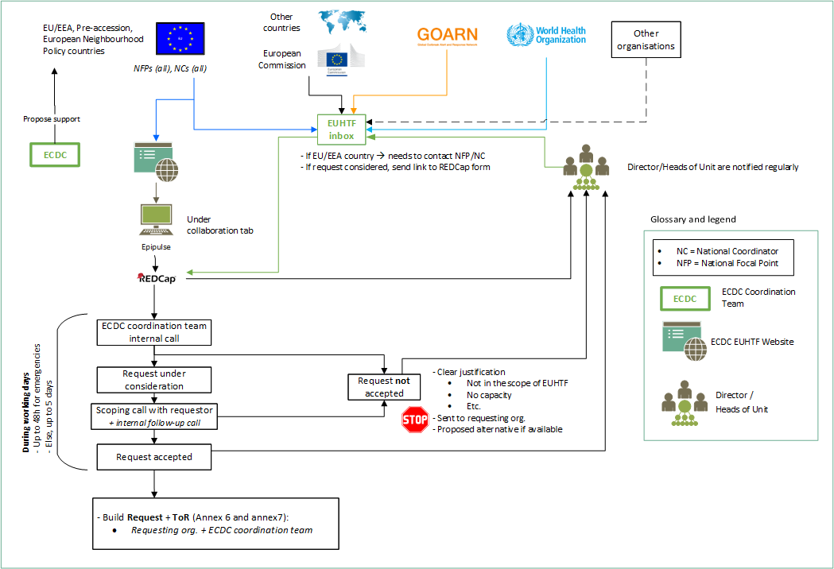
Requesting support
Notes:
Emma

Slide 29
Process for ministries of health and public health institutes to request EUHTF support
Notice of request for support
Scoping call with requesting institution
Internal meeting ECDC
Coordinating call with requesting institution
Acceptance
ToR
Assembly of team and briefing call
Evaluation at closing
Notes:
Emma

Slide 30
Process for ministries of health and public health institutes to request EUHTF support
Beehive discussion where you are seated in small groups
So far mostly requests for preparedness support:
Challenges/reasons why MS may or may not request support?
Awareness of the EUHTF?
Notes:
Emma

Slide 31
Session 3:
The EU Health Task Force in the European and global landscape - Panel discussion
Notes:
Thomas

Slide 32
Panel discussion
Chair: Thomas Hofmann
Panellists:
  Africa CDC: Aragaw Merawi
  DG HERA: Isabella Panunzi
  EMPHNET: Haitham Bashier
  EUHTF: Ettore Severi
  France: Clement Lazarus
  G7-DE: Christophe Bayer
  Portugal: Mariana Ferreira
  WHO GHEC: Scott Dowell
Objectives
Share knowledge and lessons learnt from national and supranational initiatives to support preparedness and response to public health emergencies
Identify existing gaps in international preparedness and response support
Notes:
Thomas

Slide 33
Session 4:
Being part of the pool – Process and assignments
Notes:
Adriana

Slide 34
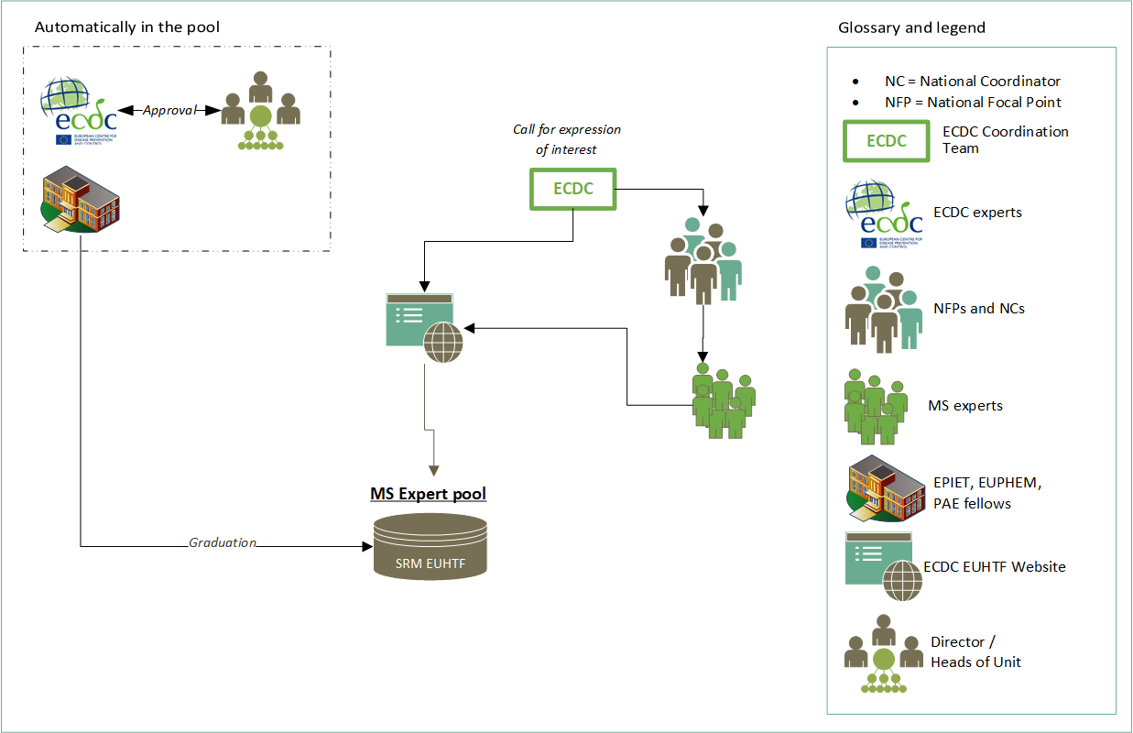
Pool of experts
Notes:
Adriana

Slide 35
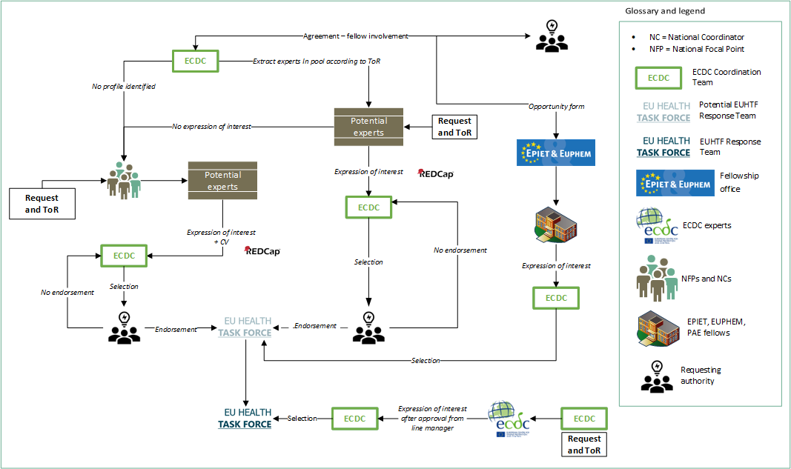
EUHTF Response Team: how would you be involved?
Notes:
Adriana

Slide 36
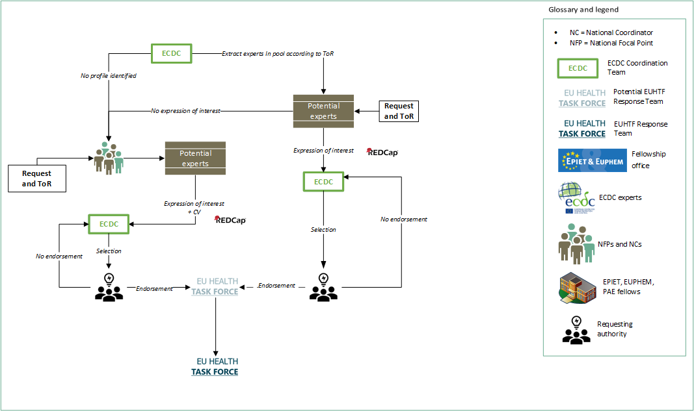
EUHTF Response Team: how would you be involved?
Notes:
Adriana – pool and cascade NFPs in 2 steps?

Slide 37
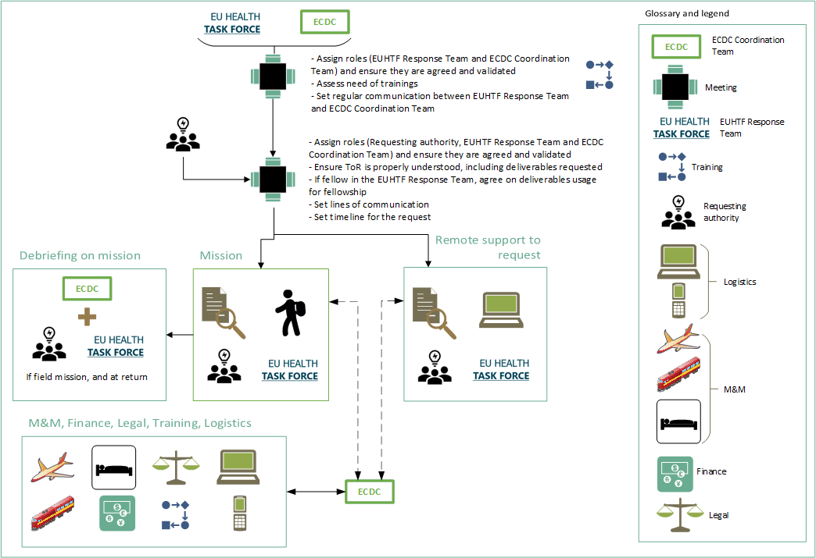
Assignment
Notes:
Adriana

Slide 38
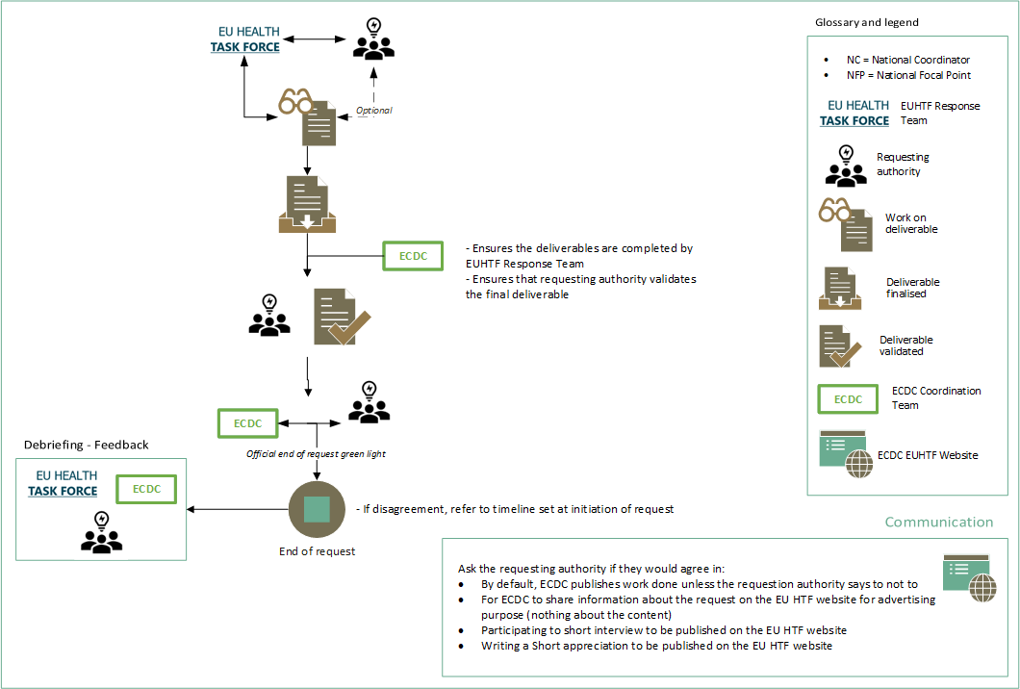
End of request
Notes:
Adriana

Slide 39
Day 2
Group picture
Support for reimbursement
Day 2 | Friday 26 January 2024
09:00-09:15 | Wrap up day 1
09:15-09:45 | Session 5: opportunities for the Enhanced Emergency Capacity pool of experts
09:45-10:30 | Session 6: expectations for 2024 Presentation of the new EUHTF Advisory Group Reflections on the work done in 2023 Expectations and plans for 2024
10:30-11:00 | Coffee Break (social area in 5th floor)
11:00-12:00 | Session 7: next steps in the EUHTF operationalisation with Member States and international partners
12:00-12:30 | Conclusion and meeting closure
12:30-13:30 | Lunch (5th floor) – Takeaway wrap
Notes:
Thomas/Ettore

Slide 40
Wrap-up of contents of first ½ day of the annual EUHTF meeting
EUHTF concept and operationalisation in 2023
Legislative background, composition, governance, coordination with European Commission, GOARN and WHO
Criteria to request EUHTF support, list of initial/main activities, prioritisation of request for support, process for national authorities to request support
Pools of EUHTF experts, registration, participation in assignments, life-cycle of an EUHTF assignment + first pilots with ECDC Fellow and MS expert
Assignments taken forward and completed in 2023
Panel: national, regional and global landscape around the EU to support preparedness and response
  Increase collaboration, avoid fragmentation
Notes:
Thomas/Ettore

Slide 41
Wrap-up of inputs of first ½ day of the annual EUHTF meeting
Expectations on assignments:
  Clarify areas for response support and bring packages
  Reflect in terms of references (ToR)
  Build trust and increase EUHTF visibility and engagement with MSs
  Learn from past outbreaks
  Define timing and expectations for support both country and expert’s perspective
  Continue working on preparedness assignments
Operational research – identified as an area where support is needed
Inform regularly NFPs, NCs, and community/pool
Coordinate training, reinforce capacity building
Suggested assignments:
  Report on timeliness from start to end
  Record person/hours of work
  Clarify public health impact associated with EUHTF support
Continue working with DG ECHO, GOARN and WHO-GHEC on complementary and overlapping
Clarify legal aspect (i.e. liability)
Notes:
Thomas/Ettore

Slide 42
Session 5:
Opportunities for the Enhanced Emergency Capacity pool of experts

Slide 43
Opportunities for the pool of experts
Not only offer to be part of field work or remote work, but also:
Take part in trainings
Be a part of a European Community of practice
Notes:
Sara

Slide 44
Opportunities for the pool of experts - Training and Community of practice
General trainings and specific trainings for deployment
  General trainings, like:
    Soft skills
    Presentation of the EUHTF
    REDCap
    Working in a multi-cultural environment/diplomacy (focus on EU/EEA )
  Trainings for deployment, like:
    Field safety during travel and at the place of assignment,
    Preparing for field work (what to do in preparation and what to do upon returning)
    Political context
    State of healthcare system
Notes:
Sara

Slide 45


Where do you think the focus of the training programme should be? Select up to three options.
ⓘ Start presenting to display the poll results on this slide.
Notes:
Sara

Slide 46
To be deployed, the completion of trainings should be:
ⓘ Start presenting to display the poll results on this slide.
Notes:
Sara

Slide 47
Opportunities for the pool of experts - Training and Community of practice
Online platform for community of practice
  Webinars on topics of interest
  Lessons learnt from deployments
  Testimonies
  Q&A
→ What would you like to see in such platform?
Notes:
Sara

Slide 48

What would you like to see in such platform?
ⓘ Start presenting to display the poll results on this slide.
Notes:
Sara

Slide 49
Session 6:
Work in 2023 and expectations for 2024

Slide 50
Members of the Ad Hoc EUHTF Working Group
ECDC Coordination Team
Vicky Lefevre, chair - Head of Unit – Public Health Functions
Thomas Hofmann, Head of Section - Emergency Preparedness and Response Support
Ettore Severi – Lead EPR Readiness and Support Group
Adriana Romani - EPRS
Daniel Cauchi – EPRS
Dorothée Obach– EPRS
Emma Löf - EPRS
Hanh Vu Hong – EPRS
Katarina Johansson – PHF
Orla Condell – EPRS
Sara Forato – EPRS
Svetla Tsolova – EPRS
MS Representatives
Bernardo Guzmán Herrador, Spain
Claudia Siffczyk, Germany
Emily MacDonald, Norway
Otto Helve, Finland
Paula Vasconcelos, Portugal
Teoklis Zaoutis
European Commission DG representatives
Anna Battistutta, DG ECHO
Isabella Panunzi, DG HERA
Evelyn Depoortere, DG RTD
Laura Gillini, DG SANTE
Alexandre Jully, DG ECHO (alternate)
GOARN representative
Gianluca Loi, GOARN OST
Notes:
Ettore

Slide 51
Ad Hoc EUHTF Working Group actions and results in 2023
Support development of:
Concept note (including menu of EUHTF activities, expert profiles, visualisations)
Procedures and vision for the EUHTF
  Criteria for request for support and related prioritisation
  Process from requesting support to end of the request, including building an EUHTF Response Team, follow-up and closure of a request
  Criteria for building the pool of experts
EUHTF Advisory Group terms of reference
Scope and objectives of the 1st annual EUHTF meeting
Identification of potential challenges in the operationalisation of the EUHTF (timelines, insurance, data management over an assignment, data protection)
Communication and training plans
Notes:
Svetla

Slide 52
Members of the EUHTF Advisory Group
European Medicines Agency
Manuela Mura
European Public Health Association
Ricardo Mexia
Médecins Sans Frontières (MSF)
Daniela Garone
ECDC Coordination Team
Vicky Lefevre, chair - Head of Unit – Public Health Functions
Thomas Hofmann, Head of Section - Emergency Preparedness and Response Support
Ettore Severi – Lead EPR Readiness and Support Group
Adriana Romani - EPRS
Daniel Cauchi – EPRS
Dorothée Obach– EPRS
Emma Löf - EPRS
Hanh Vu Hong – EPRS
Katarina Johansson – PHF
Orla Condell – EPRS
Sara Forato - EPRS
Svetla Tsolova – EPRS
MS Representatives
Bernardo Guzmán Herrador, Spain
Claudia Siffczyk, Germany
Guido Benedetti, Denmark
Mairin Boland, Ireland
Otto Helve, Finland
Paula Vasconcelos, Portugal
European Commission DG representatives
Anna Battistutta, DG ECHO
Isabella Panunzi, DG HERA
Evelyn Depoortere, DG RTD
Laura Gillini, DG SANTE
Alexandre Jully, DG ECHO (alternate)
GOARN representative
Gianluca Loi, GOARN OST
WHO EURO
Oleg Storozhenko
Adela Paez (alternate)
Notes:
Ettore

Slide 53
Terms of reference of the EUHTF Advisory Group
Support & advise ECDC on operational, administrative and technical decisions for EUHTF routine management:
Identify priority areas of work and annual work planning
Review EUHTF working modalities including requests for assistance and mobilisation of the EUHTF
Engagement and mobilisation of expertise from the EUHTF Enhanced Emergency Capacity expert pools
Review of protocols, resources and tools
Evaluation on the process, procedures and functioning of the EUHTF to advise on revisions, to ensure continuous learning and improvement
Suggest opportunities for EUHTF assignments in Member States, in collaboration with the European Commission and international partners
Advice on ongoing communication/awareness campaigns related to the EUHTF
Support collaborations with stakeholders (networks, DGs, etc.)
Notes:
Svetla

Slide 54
Expectations from Advisory group towards the EUHTF and ECDC Coordination Team
Timely information sharing, alignment with NFPs for Prep & Resp. and keep them updated
Regularly inform the larger network with updates (including needs) – e.g., regular webinar or newsletters
Finalise implementing act in 2024 and keep DG SANTE and EC initiatives updated
Increase the harmonisation between EUHTF and partners procedures (DG ECHO, GOARN, WHO)
Strengthen close coordination (deployment, training) and discuss role of EUHTF in preparedness and capacity-building with partners
Strengthen partner engagement
Promote and emphasis research agenda and activities
Work on communication
Strengthen action plan and priorities, particularly complementarity with international organisations
Notes:
Ettore

Slide 55
What are your expectations towards the
EU Health Task Force?
Notes:
Svetla

Slide 56
Session 7:
Next steps in the EUHTF operationalisation with Member States and international partners

Slide 57
Next steps in the EUHTF operationalisation
Launch the pool of MS experts / send requests to MS experts
  Automatically engage with alumni of the ECDC fellowship and PAE: test of a platform for the pool of experts
  Email to NFPs/consider other networks to cascade in their network for interest to answer to a request
Extend platform for pool of MS experts
  Send interest to join the pool of expert
Develop platform for the pool of experts (community of practice)
Develop internal (ECDC) platform for a better follow-up of requests
  Timeliness / Harmonised process
First list of trainings

Slide 58
Next steps in the EUHTF operationalisation
Engagement of MS
Increase awareness for MS to request support from EUHTF
Support the mechanism by providing experts, feedback and suggestions
Further opportunities to engage in the EUHTF:
  by being part of the next Advisory Group,
  by visiting/meeting with national Rapid Response Teams to promote learning and synergies,
  by suggesting forums where the EUHTF perspective can be relevant (congress, meeting, networks, etc.)
  Increase communication around the EUHTF:
  Newsletter
  Develop the website
  Participate to conferences (Global Health Security Conference, ESCAIDE, ECMID, etc.)

Slide 59
Next steps in the EUHTF operationalisation
Apply as GOARN member
Implementing act
2nd Advisory Group meeting in late April 2024
Annual meeting of the EUHTF, back-to-back with ESCAIDE 2024
→ Collaborative work where your support is needed at different levels: as part of the pool, as requesting organisation, as advisor and promoter
What would you see in addition?

Slide 60
Closure of the
1st Annual meeting EUHTF

Slide 61
Closure
Day 2
Started with wrap-up of day 1
Discussion on training; mandatory or adapted to the situation? Some basic mandatory training for members signing up in the pool but complement with specific training if needed (not technical)
Work of the EUHTF Advisory group
Next steps of the operationalisation of the EUHTF

Slide 62
Closure
Some take aways for the EUHTF
  Continue to establish close coordination (deployment, training) with partners and discuss role of EUHTF in ad-hoc preparedness activities
  Continue working to identify gaps, aspects and ways of working where EUHTF can support in the context of outbreak response and public health emergencies
  Build trust and increase and engagement with Member States
  Continue working on the visibility and communication around the EUHTF
  Mechanisms:
    Upon request
    Clearly defined ToR developed and agreed with the national level
    Clarify legal aspect (i.e. liability) of the experts deployed with the EUHTF
  win-win: knowledge sharing, community of practice, capacity-strengthening ("extra pair of hands")

Slide 63
Thanks

Slide 64
Back-up slides

Slide 65
Legal framework of the EUHTF
Regulation 2022/2370 Expanded ECDC mandate
Regulation 2022/2371 Cross-Border Threats to Health

Slide 66
Regulation 2022/2371
Article 11: Training of health care and Public Health staff
The Commission may organise training activities, and those activities shall be organized in cooperation with MS as well as with the ECDC, in particular the EU Health Task Force
Article 25: Effect of the recognition (of a Public health Emergency at the EU level)
The recognition of a public health emergency at Union shall have the legal effect of enabling the introduction of the activation of support from the ECDC to mobilise and deploy the EU Health Task Force

Slide 67
Regulation 2022/2370
General provisions:
The ECDC should establish appropriate capacities to support international, cross-border interregional and field response, in accordance with Regulation (EU) 2022/2371. Those capacities should enable the Centre to mobilise and deploy outbreak assistance teams, known as the ‘EU Health Task Force’, to assist in local responses to disease outbreaks and collect field data. The ECDC should therefore ensure that it has a permanent capacity to carry out missions in Member States, as well as in third countries, and to provide science-based recommendations on response to health threats.
The Centre should also support the strengthening of preparedness capacities under the IHR in third countries, in order to address serious cross-border threats to health and the consequences thereof. In order to strengthen the operational interface between the Centre and Member States, the Centre should maintain mechanisms for regular secondments between the Centre, the Commission, Member States’ experts and international organisations, as well as introduce systematic and permanent working arrangements within the Centre, for example through desk officers.
The EU Health Task Force to be developed by the Centre to support responses to outbreaks of diseases which can spread within or to the Union should be permanent and be accompanied by a framework for its mobilisation.

Slide 68
Regulation 2022/2370
Article 3: Mission and tasks of the ECDC
Support through the EU Health Task Force referred to in Article 11a, epidemic and outbreak response in Member States, based on in-depth country knowledge, and in third countries in cooperation with the WHO, in a manner that is complementary to, and in close coordination with, other emergency response instruments, in particular the Union Civil Protection Mechanism, and relevant instruments on the stockpiling of medical countermeasures
Article 5b: Prevention preparedness and response planning
Maintain regular secondment mechanisms between the Centre, the Commission, Member States’ experts and international organisations, including a EU Health Task Force

Slide 69
Regulation 2022/2370
Article 11a: Support for international and field preparedness and response
The ECDC shall establish a EU Health Task Force and ensure that there is a permanent capacity and an enhanced emergency capacity to mobilise and use it.
The EU Health Task Force shall provide assistance with regard to requests for prevention, preparedness and response planning, local responses to outbreaks of communicable diseases and after-action reviews in Member States and in third countries, in cooperation with the WHO.
The EU Health Task Force shall include the Centre’s staff and experts from Member States, fellowship programmes and international and non-profit organisations.
The ECDC shall develop capacities to conduct field epidemiology and research, and gather relevant data, such as on the variants of communicable diseases, using the dedicated network of EU reference laboratories or its own resources.
The ECDC shall develop a framework to define the organisational structure and the use of the permanent capacity of the EU Health Task Force.
At the joint request of the Commission and Member States, the enhanced emergency capacity of the EU Health Task Force shall be mobilised. The Commission shall, by means of implementing acts, adopt the procedures concerning the mobilisation of the enhanced emergency capacity of the EU Health Task Force.

Slide 70
Article 11a: Support for international and field preparedness and response
ECDC shall ensure that the EU Health Task Force is coordinated with, complementary to and integrates the capacities of the European Medical Corps, other relevant capacities under the Union Civil Protection Mechanism and mechanisms of international organisations.
Through the EU Health Task Force, the Centre shall provide Union field response experts in international response teams mobilised by the WHO Health Emergencies Programme mechanism and the Global Outbreak Alert and Response Network (GOARN), in accordance with appropriate working arrangements established with the Commission.
The Centre shall facilitate the development of field response capabilities and crisis management expertise among the Centre’s staff and experts from Member States and EEA countries, from candidate countries and potential candidates, as well as from European Neighbourhood Policy countries and partner countries, at the request of the Commission and in collaboration with the Member States.
By establishing a mechanism for mobilising and using the EU Health Task Force, the ECDC shall maintain the permanent capacity of the EU Health Task Force and enhance the country-specific knowledge necessary to carry out missions to Member States, at the joint request of the Commission and Member States concerned, to provide science-based recommendations on preparedness for and response to threats to health and to carry out after-action reviews, within its mandate.

Slide 71
Why an Implementing act?
In order to ensure uniform conditions for the implementation of this Regulation concerning the rapid mobilisation and responsiveness of the EU Health Task Force, implementing powers should be conferred on the Commission (in both Regulations)

Slide 72
What is asked to register in the pool?
Personal details | Surname
 | Firstname
 | Address
 | City
 | Country
 | e-mail
 | e-mail 2
 | Mobile phone
 | phone
 | Date of birth
 | Address
 | Passport citizenship
 | Organisation/workplace
Expertise
Disease group
Areas of competence
Language
Upload CV
DoI
Public Health Epidemiologist
Public Health Microbiologist
Public Health Preparedness and Response expert
Emergency operations centre (EOC) expert
Infection prevention and control (IPC) expert
Points of Entry/Border Health expert
Risk communicator
Other:
Social scientist
Data manager
Entomologist
Geographic Information Systems (GIS) expert / Geographer
High consequence infectious diseases expert
Water and sanitation (WASH) experts / Water system expert
One health expert
+ n years of experience

Slide 73
What is asked to register in the pool?
Personal details | Surname
 | Firstname
 | Address
 | City
 | Country
 | e-mail
 | e-mail 2
 | Mobile phone
 | phone
 | Date of birth
 | Address
 | Passport citizenship
 | Organisation/workplace
Expertise
Disease group
Areas of competence
Language
Upload CV
DoI
AMR
Emerging diseases
FWD
HAI
Influenza
Respiratory diseases
Sexually transmitted infection
Tropical diseases
TB
Vaccine preventable diseases
Vector-borne disease
Viral hepatitis
Zoonosis

Slide 74
What is asked to register in the pool?
Behavioural and social sciences
Bioinformatics
Biosafety and biosecurity
Data analyses
Data management
Emergency response
Emergency response management
Environmental health
Epidemic intelligence
Evidence-based methods
Health communication
Hygiene and infection control
Mathematical modelling
Microbiology
One Health
Operational research
Outbreak investigation
Public health crisis
Public health policy
Public health programme monitoring and evaluation
Refugee/migrant health
Risk assessment
Risk management
Sexual health
Social sciences
Statistics
Surveillance
Training and capacity development
Vaccination
Water and sanitation (WASH)
Personal details | Surname
 | Firstname
 | Address
 | City
 | Country
 | e-mail
 | e-mail 2
 | Mobile phone
 | phone
 | Date of birth
 | Address
 | Passport citizenship
 | Organisation/workplace
Expertise
Disease group
Areas of competence
Language
Upload CV
DoI
Chose up to 5

Slide 75

EUHTF webpage

Slide 76

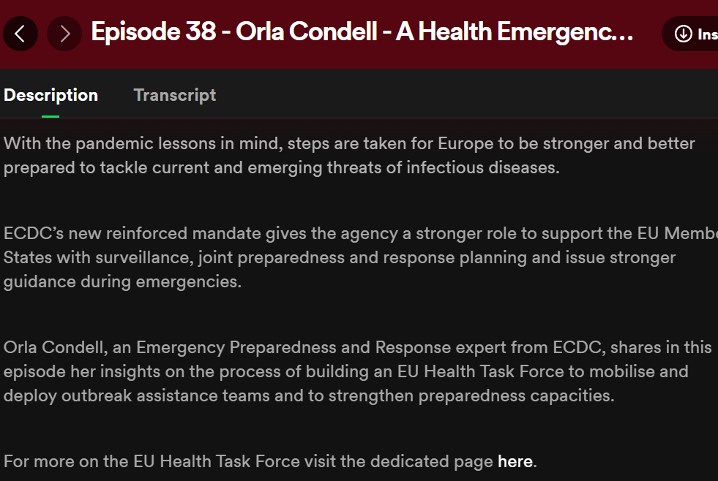
ECDC podcast On Air
Episode 38

Slide 77
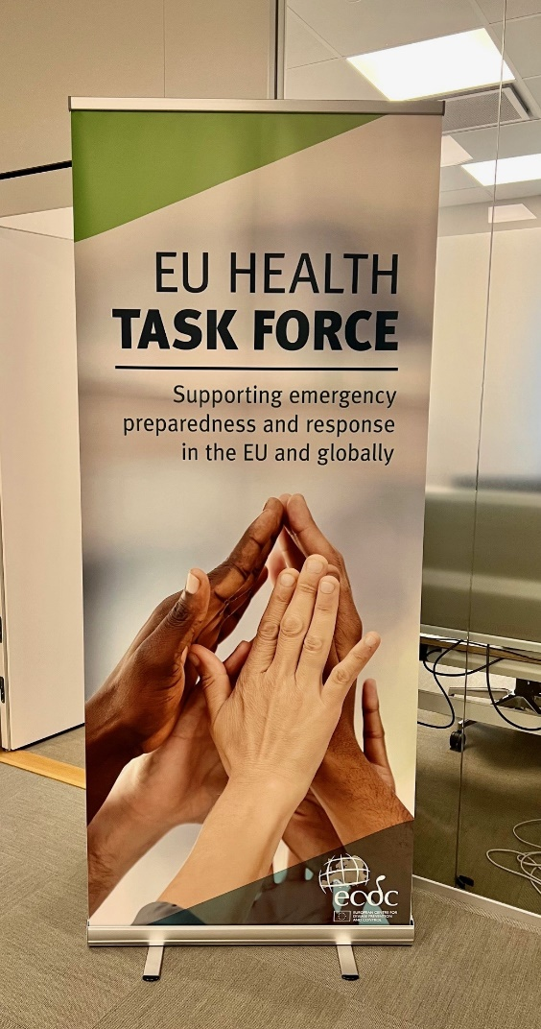

Banner

Slide 78
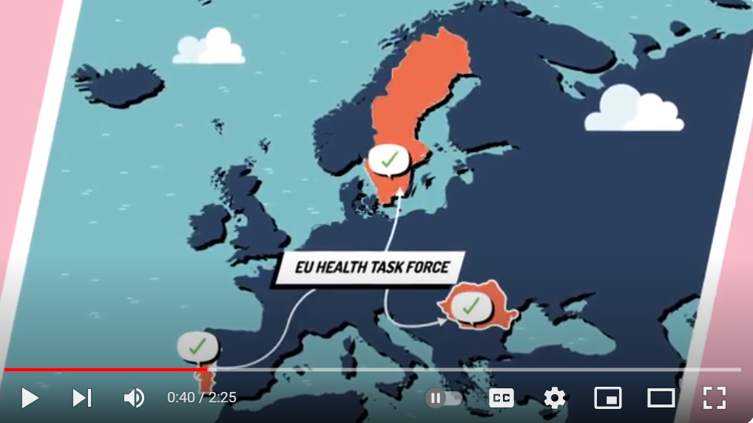
Animation

Slide 79
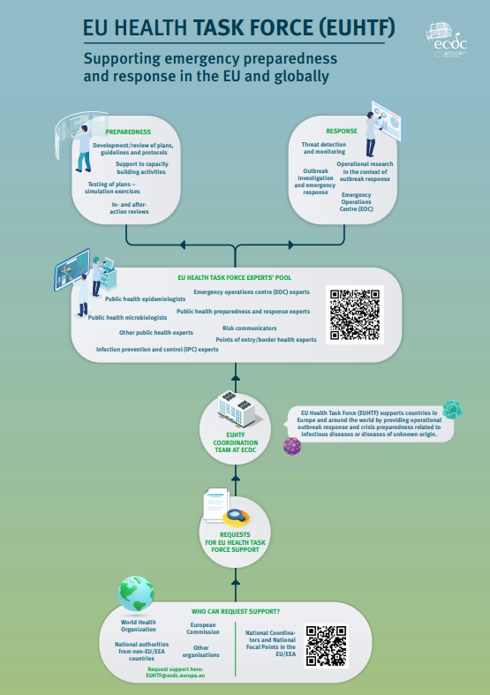
Infographic:
Work in Progress

Slide 80

Thank you

