Slide 1
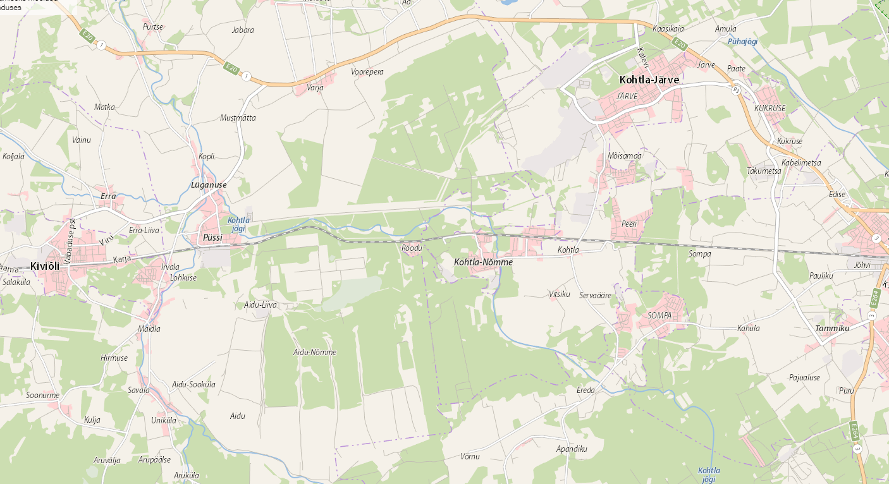
43701:003:0310
43801:001:0187
43801:001:0188
15 km
44201:001:0817
43801:001:0123
Viru radar

